Slide 1
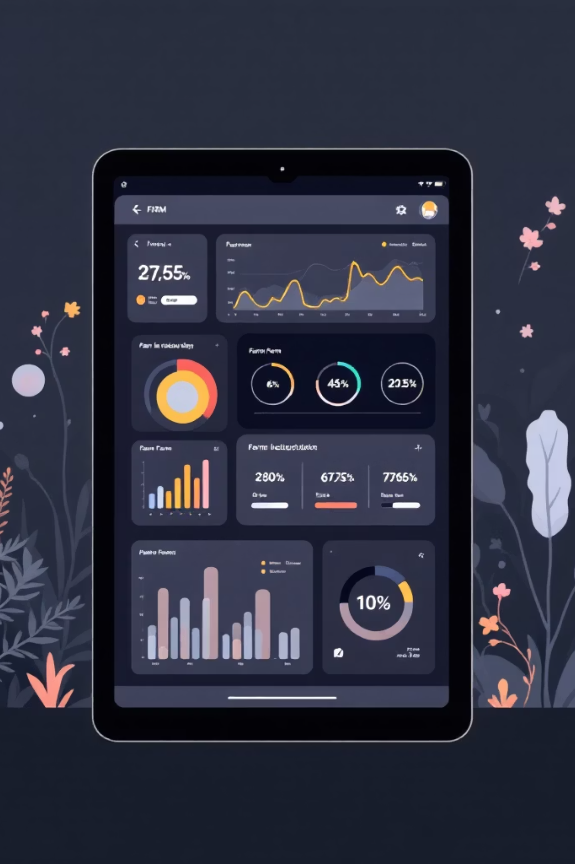
Digital Harvest: Agricultural Administration Web Application
This project aims to revolutionize farm management with a unified web interface, providing clarity and control over all essential operations. From animal tracking to financial oversight, our application streamlines daily tasks for modern agriculture.

Slide 2

Unified Interface, Clear Overview
Upon logging in, users are greeted by an intuitive summary homepage, the Dashboard, offering immediate insights into critical farm indicators. This central hub ensures farm managers have a holistic view of their operations at a glance.
Number of Animals
Financial Balance
Instant count and status of your livestock.
Real-time updates on your current financial standing.
Upcoming Tasks
Basic Statistics
Key deadlines and activities to keep your farm running smoothly.
Essential performance metrics for informed decision-making.

Slide 3
Core Functional Modules
Our application is structured around dedicated modules, each designed to manage specific aspects of farm administration with precision and ease. These modules seamlessly integrate to provide a comprehensive management solution.
🐄 Animals Module
🌱 Lands Module
Detailed registration and health tracking for each animal.
Efficient management of all owned and leased land areas.
Adding new animals: Species, ID, age, stable, notes.
Individual profiles: Comprehensive view for each animal.
Health records: Veterinary notes and document storage.
Plot registration: Name, cadastral number, size.
Work process tracking: Monitor activities on each plot.
📁 Documentation Module
💸 Budget Module
Centralized, organized storage for all vital farm documents.
Categorized financial management with automated calculations.
Document types: Lease agreements, subsidy forms, official documents.
Features: Organized storage and easy download options.
Transaction tracking: Income and expense recording.
Automatic balancing: Real-time financial overview.
Reports: Monthly breakdowns and annual summaries.

Slide 4
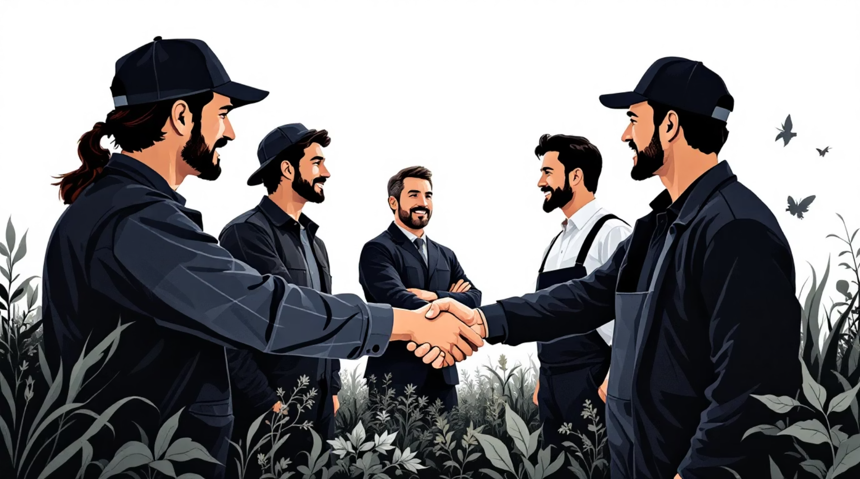
Engagement & Commerce
Beyond internal management, our application empowers users to connect with stakeholders and engage in commerce through dedicated modules designed for communication and marketplace activities.
👥 Clients Module
A unified database for all critical contacts, fostering better relationships.
Contact types: Buyers, partners, and other essential contacts.
Extra feature: Convenient mass email sending for announcements and updates.
🛒 Marketplace Module
An integrated platform for advertising farm products and assets directly.
Listing options: Advertise animals and land for sale.
Detailed listings: Upload prices, descriptions, and images to attract buyers.

Slide 5
Robust Technology Stack
Built on modern, reliable technologies, our web application ensures a seamless, secure, and scalable experience for all farm administration needs.
Frontend
1
HTML5, CSS3, JavaScript, Bootstrap
2
Backend
PHP, REST-like endpoints
Database
3
MySQL / MariaDB
4
Development Tools
Visual Studio Code, Git, GitHub
These technologies form the backbone of our application, guaranteeing performance and maintainability.

Slide 6
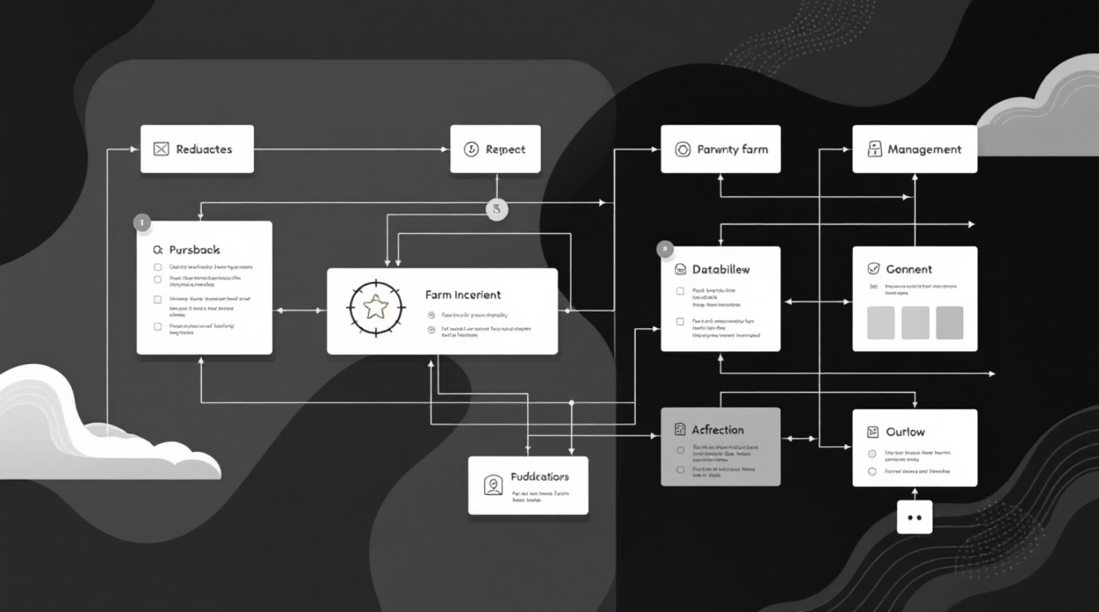
Collaborative Development & Structure
Our project's success hinges on a clear division of labor and shared responsibilities, ensuring efficient progress from design to deployment. The database is meticulously structured to support all functional areas.
👨‍💻 Work Distribution
Developer "A" Focus:
Backend development & database management
Animals & Lands module logic
Email sending functionality
Developer "B" Focus:
Frontend design & UX
Budget, Clients & Marketplace interfaces
Graphic elements design
🗄️ Database Structure: Key Tables
🤝 Shared Responsibilities
Our robust database design underpins all application functionalities, ensuring data integrity and efficient retrieval.
Dashboard development
Testing & bug fixing
Final documentation
users
animals
animal_docs
lands
land_logs
clients
expenses
incomes
marketplace

Slide 7
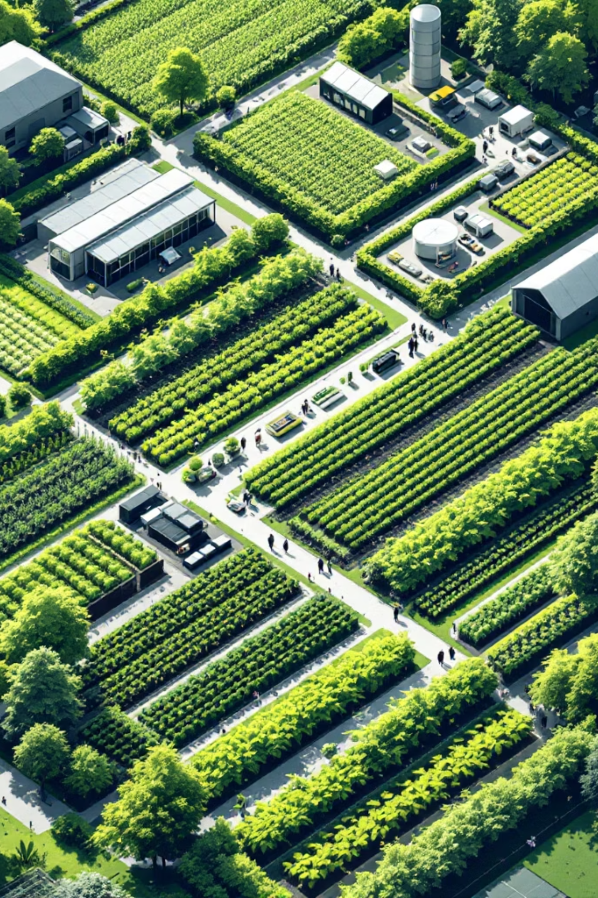
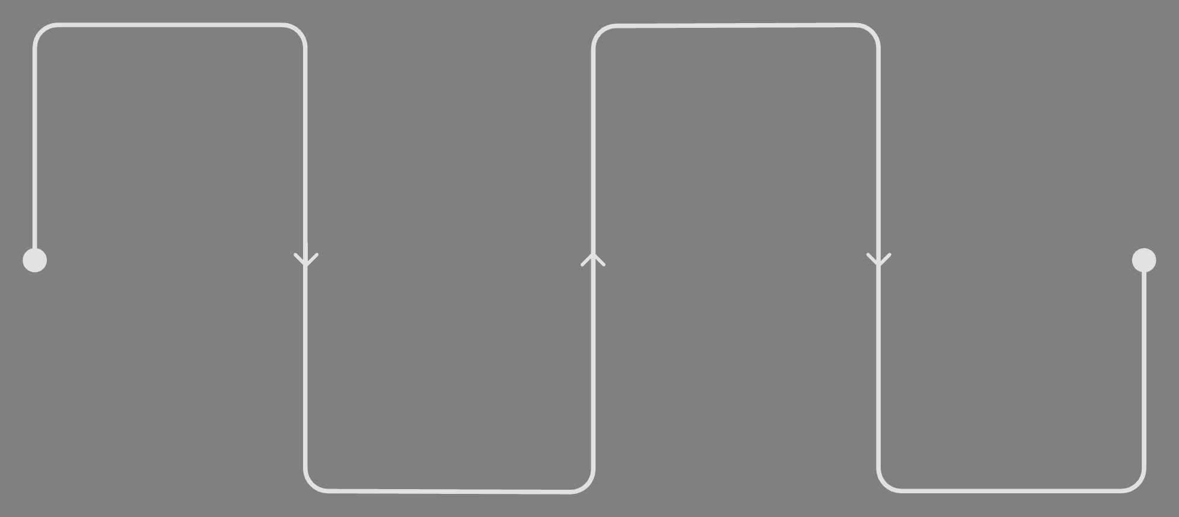
Project Timeline & Vision
Our development roadmap is carefully planned to deliver a high-quality application within a structured timeframe, leading to a modern and user-friendly farm management solution.
Define Requirements
Develop Modules
Implement features sequentially
Clarify goals and DB design
Test & Document
Build Base
Set up project structure
Optimize, test, and document
This structured approach ensures a seamless progression from conceptualization to a fully functional web application, effectively supporting agricultural administration.

